Slide 1
Using Square with your Council / Assembly
Notes:
This presentation is designed to briefly explain how to setup and use Square in your council or assembly. All though not officially endorsed by the supreme council, we will also go over best practices and methods that hey suggest when using this service.

Slide 2
What is Square?
Notes:
What is Square?

Slide 3
What is Square?
Square helps all sizes and types of businesses to accept contactless payments, including all major credit and debit cards and mobile payments, in person and online
Notes:
Square is a service that allows your council or assembly to accept credit, debit and mobile payments in person and online.

Slide 4
What is the cost?
Notes:
So what does this service cost?

Slide 5
What is the cost?
Sell in person, online, over the phone, or out in the field. No setup fees or monthly fees — only pay the processing fee when you take a payment.
Notes:
Whether accepting payments in person or online the only fee you pay is the processing fee at the moment of payment. There are no setup or recurring fees. To put it simply if you are not using it then you are not paying for it.

Slide 6
What are the processing fees?
Notes:
What are the processing fees?

Slide 7
What are the processing fees?
Card present When a customer taps, dips, or swipes their card in person. Visa, Mastercard, Discover, and American Express all cost the same rate. 2.6% + 10¢ per transaction
Notes:
Swiping a card or taking a mobile phone payment in person is only 2.6% of the transaction + 10 cents so for example if I sold a fundraiser dinner for $10 Square would take 36 cents and send $9.64 to my bank account.

Slide 8
What are the processing fees?
Card present When a customer taps, dips, or swipes their card in person. Visa, Mastercard, Discover, and American Express all cost the same rate. 2.6% + 10¢ per transaction
Card not present When a customer makes a purchase through your Online Store, Online Checkout, eCommerce API, or pays an invoice online. 2.9% + 30¢ per transaction
Notes:
Online sales through a website or invoices sent via email the Square fee is 2.9% of the transaction plus 30 cents. So if I were to sell $10 dollars worth of raffle tickets online Square would take 59 cents and transfer $9.41 to my bank account.

Slide 9
What are the processing fees?
Card present When a customer taps, dips, or swipes their card in person. Visa, Mastercard, Discover, and American Express all cost the same rate. 2.6% + 10¢ per transaction
Card not present When a customer makes a purchase through your Online Store, Online Checkout, eCommerce API, or pays an invoice online. 2.9% + 30¢ per transaction
Keyed in When you manually key in your customer’s card details or use a card on file. 3.5% + 15¢ per transaction
Notes:
If you key in someone's credit card information manually either in person or using the online terminal this takes away from some of the credit card security so it is not recommended. The fee is 3.5% of the transaction plus 15 cents. So on a $10 dollar sale the fee would be 50 cents and $9.50 to my bank account.

Slide 10
How can we take payments?
Notes:
How can you take payments with Square?

Slide 11
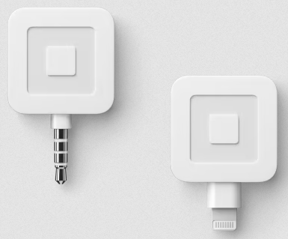
How can we take payments?
Smartphone Magnetic Stripe Reader
Works with iOS and Android
With two versions of Square Reader for magstripe—one for a headset jack, the other a Lightning connector—you’re covered. Just pick the credit card reader that works for you.
Get paid any way you like with the Square Point of Sale app.
COST - FREE
Notes:
You can get free magnetic stripe readers from the Square website. These readers work with most Android and iPhones as long as they have the headphone 1/8” port or Apple lighting port.

Slide 12
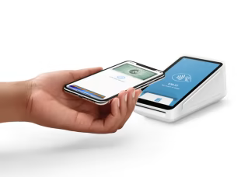
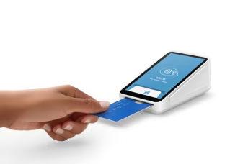
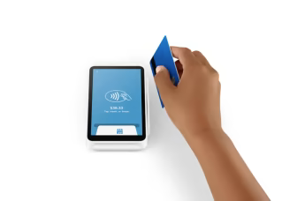
How can we take payments?
Square Terminal
Square Terminal is an all-in-one credit card machine for your business. Take payments and print receipts. It’s secure, reliable, and an entirely faster way to get paid.
COST - $299 plus tax (free shipping)
TAP
CHIP
SWIPE
Notes:
You can purchase a Square all in one terminal which has a magnetic stripe reader, a chip reader, and a mobile pay tap reader. This unit can also print physical receipts. The cost is $299 plus shipping and handling.
It does require a fully charged battery or power from a wall outlet and a secure wireless internet connection. You can find out more about this unit and other accessories on the Square website.

Slide 13
How can we take payments?
Square Online Checkout
Free to use. You only pay 2.9% + 30¢ when you make a sale.

Slide 14
How can we take payments?
Square Online Checkout
Free to use. You only pay 2.9% + 30¢ when you make a sale.
Fast and easy checkout
Customize your checkout page—add a name, image, and price. Offer subscriptions and collect tips. Accept customer payment easily with Apple Pay, Google Pay, and credit card.
Notes:
You can take payments online through your own website or you can build a free eCommerce website within the Square website using your account.
You can have brother knights pay there dues online or do pre-selling to the public for an event or item.

Slide 15
How can we take payments?
Square Online Checkout
Free to use. You only pay 2.9% + 30¢ when you make a sale.
Fast and easy checkout
Customize your checkout page—add a name, image, and price. Offer subscriptions and collect tips. Accept customer payment easily with Apple Pay, Google Pay, and credit card.
Flexible formats
Pick the format option that works best for your business—payment links, buy buttons, or QR codes. Share them through social media, email, text, or on a website.
Notes:
You can even sell on your social media page or generate a custom QR code people can scan and pay with their cell phone.

Slide 16
How can we take payments?
Square Invoices
Get paid faster. Send unlimited invoices, estimates, contracts, and more for free.
Notes:
You can send invoices.

Slide 17
How can we take payments?
Square Invoices
Get paid faster. Send unlimited invoices, estimates, contracts, and more for free.
Unlimited invoicing, estimates, and contracts
Unlimited users
Unlimited customers
Access from anywhere
Send via email, SMS, or by manually sharing a link
Accept payments 24/7
2.9% + 30¢ (online card payment)
1% with minimum fee of $1 (online ACH payment)
Notes:
With invoices you can send them as one time or recurring .
You can email or text the invoices.
Invoicing allows the payee to enter bank routing codes to pay via ACH.

Slide 18
What would we use this for in the council / assembly?
Notes:
So what could you use Square for?

Slide 19
What would we use this for in the council / assembly?
Take Dues payments
Notes:
Take dues payments at meetings with a reader. Send email invoicing to members or even have them on auto draft with recurring invoices.

Slide 20
What would we use this for in the council / assembly?
Take Dues payments
Accept Credit Cards at fundraisers
Notes:
Accept credit card for whatever your selling after church.

Slide 21
What would we use this for in the council / assembly?
Take Dues payments
Accept Credit Cards at fundraisers
Create unique ways to pay in unique scenarios
Notes:
Use the payment system in a way you never thought about.
My assembly is able to offer a 6 month no interest loan to any member that wishes to purchase the new regalia but can’t afford the upfront cost. We set them up for a recurring invoice for 6 months that auto charges their credit card or bank account each month until the loan is paid off.

Slide 22
How do we keep our financial records updated?
Notes:
How do you keep your books straight?

Slide 23
How do we keep our financial records updated?
Square Online Dashboard
See all of your reports in one place with Custom Reports in your online Square Dashboard. You can create customized, export reports in minutes.
Notes:
The online dashboard on your Square service account allows you to create and download reports to help you see what fees were taken out and what money was sent to your bank account and what was paid for.

Slide 24
How do we get started?
Notes:
How do you get started?

Slide 25
How do we get started?
Sign up using a Council / Assembly email address, not a personal email address
Notes:
Create and email address for your council or assembly, something that can be transferred when officers change. Do not set this up on your personal email account.

Slide 26
How do we get started?
Sign up using a Council / Assembly email address, not a personal email address
Setup Council/Assembly banking information in your Square account so collected funds will transfer to your bank account
Notes:
Enter and confirm your council or assembly’s bank information so that Square can transfer your funds within 48 business hours of the transaction.

Slide 27
How do we get started?
Sign up using a Council / Assembly email address, not a personal email address
Setup Council/Assembly banking information in your Square account so collected funds will transfer to your bank account
Setup items for sale and invoices as needed
Notes:
Setup common items that you know you will charge for year round in your account so you can easily pull them up on any of the Square interfaces.

Slide 28
How do we get started?
Sign up using a Council / Assembly email address, not a personal email address
Setup Council/Assembly banking information in your Square account so collected funds will transfer to your bank account
Setup items for sale and invoices as needed
Make sure you have plenty of members trained on use
Notes:
Make sure you have a few members that know how to use the service so one person is not stuck trying to do everything.

Slide 29
Q&A
Any questions?
Notes:
Any Questions?

Slide 30
Contact
State Technology Director
Brett Cormier
tech@louisianakc.org
VIVAT JESUS!
Notes:
Thanks you for your time, My contact information is on the screen if you need further assistance.
Thank you.
Vivat Jesus

